Slide 1
Recommendation of Alternative Restaurants
Capstone Project - The Battle of Neighborhoods

Slide 2
Use case
Nowadays it is very common for people to research for a restaurant online before a meal to order food online or to make a reservation. What if the restaurant is not delivering currently or has no table when you visit or make reservation? You start the search all over again. The goal of this project is to provide an algorithm to recommend an alternate restaurants that are the "closest" to your first choice.

Slide 3
Business Problem
In this project we will create a recommender system for alternate restaurants in Mumbai, Maharashtra, India. The target audience of this project will be any food delivery apps like Zomato, UberEats, FoodPanda, Swiggy or restaurant table reservation apps like EazyDiner, Zomato, etc.
The aim of this project is to provide a user with an alternate restaurant options based on the target restaurant of the user when the target restaurant is not delivering at this time or there is no reservation available when they are using any of the above apps for food delivery or table reservation.
We will use our data science powers to generate a relevant recommendation to the user based on the target restaurant, distance from there, pricing, type of cuisine and average user rating. The smarter the recommendations are the more pleasant the experience will be for the user of the website or application.

Slide 4
Data
The source of data will be FourSquare
Features will include name, location, category, pricing and how busy a restaurant is
APIs used are: https://api.foursquare.com/v2/venues/explore https://api.foursquare.com/v2/venues/{venue_id}

Slide 5
Methdology
Clustering will be done for the restaurants in the area. The most similar ones will be in the same cluster.

Slide 6
Machine Learning
K-means clustering is used because:
It is Easy to implement
With a large number of variables, K-Means may be computationally faster than hierarchical clustering (if K is small).
K-Means may produce higher clusters than hierarchical clustering
Pandas get_dummies was used to do the one-hot encoding and sklearn.preprocessing StandardScaler was used to normalize the numeric features.

Slide 7
Results
Here are the clusters of the restaurants:
Cluster 1 - Mainstream restaurants
Cluster 2 - Cheap Chinese places
Cluster 3 - Cafes
Cluster 4 - Premium Asian Restaurants

Slide 8
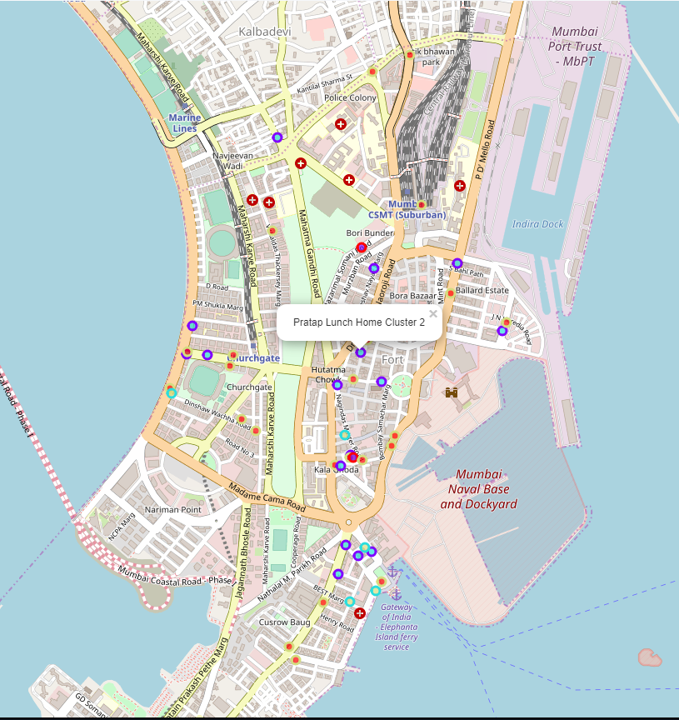
Clustered Result

Slide 9
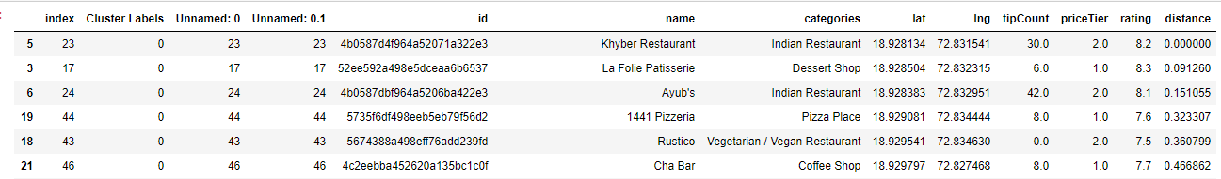
Using the restaurant Khyber Restaurant as an example showing the top 5: (First row is the original restaurant hence a distance of 0)

Slide 10
Limitation Faced with the free FourSquare account
The explore API only returned 100 venues
Information like visits count are also
Only 50 calls per day to get the details of a venue
To work around this limitation the intermediate result is stored in csv so the result can be used for the rest of the day

Slide 11
Potential Improvements
Some ideas of collecting more features include:
get an more accurate picture of how busy a restaurant is from the "visit counts" of the paid FourSquare account.
Use image recognition services to see what kinds of dishes people take photos of
Use natural language processing to see what dishes the restaurants offer in the menu posted
The data set size is also smaller due to the limitation of the FourSquare free account. It can be solved by using the paid account. The process would be exactly the same.

